Slide 1
HOUSE PRICE PREDICTION PROJECT
SUBMITTED BY,
SARANYA.M

Slide 2
INTRODUCTION BUSINESS PROBLEM FRAMING
Describe the business problem and how this problem can be related to the real world.
Anyone who has booked a flight ticket knows how unexpectedly the prices vary. The cheapest available ticket on a given flight gets more and less expensive over time. This usually happens as an attempt to maximize revenue based on - 1. Time of purchase patterns (making sure last-minute purchases are expensive) 2. Keeping the flight as full as they want it (raising prices on a flight which is filling up in order to reduce sales and hold back inventory for those expensive last-minute expensive purchases) So, you have to work on a project where you collect data of flight fares with other features and work to make a model to predict fares of flights

Slide 3
CONCEPTUAL BACKGROUND OF THE DOMAIN PROBLEM
Anyone who has booked a flight ticket knows how unexpectedly the prices vary. Airlines use using
sophisticated quasi-academic tactics known as "revenue management" or "yield management". The
cheapest available ticket for a given date gets more or less expensive over time. This usually happens as
an attempt to maximize revenue based on -
1. Time of purchase patterns (making sure last-minute purchases are expensive)
2. Keeping the flight as full as they want it (raising prices on a flight which is filling up in order to
reduce sales and hold back inventory for those expensive last-minute expensive purchases)
So, if we could inform the travellers with the optimal time to buy their flight tickets based on the historic
data and also show them various trends in the airline industry we could help them save money on their
travels. This would be a practical implementation of a data analysis, statistics and machine learning
techniques to solve a daily problem faced by travellers.

Slide 4
Review of Literature
Since the airline company's privatization, the airfare pricing scheme has evolved into a complex framework of sophisticated regulations including numerical simulations that determine airfare marketing strategies . Even though these principles are still mostly unknown, research has revealed that they are influenced by a range of circumstances . Conventional characteristics such as distance, while still important, are no longer the only determinants of pricing structure. Economic, marketing, and sociological factors have all played a growing influence in determining flight pricing.
The majority of research on airfare forecasting has concentrated either on state scale or a single market. However, analysis at the business segment level is still relatively scarce. The marketing strategy is defined as the market/airport pairing in between aircraft sender and receiver.

Slide 5
MOTIVATION OF THE PROBLEM UNDERTAKEN
Air ticket price prediction is a challenging task since the factors involved in pricing dynamically change overtime and make the price fluctuate. In the last decade, researchers have incorporated machine learning algorithms and data mining strategies to better model observed prices. Among them, regression models, such as Linear Regression(LR), Support Vector Machines (SVMs), Random Forests(RF), are frequently used in predicting accurate airfare price.
Early work also considered using classification models top redict the trends of the itineraries. Ren et al. proposed using LR, Referenc e Name Work Description Problem Found Any other criteria 1 IndiGo IndiGo is one of the flight booking app which can predict the flight ticket as well as book the flight ticket.
This app predict ticket price for only of Indigo flights not for other flights. Registrati on is required 2 Ixigo Ixigo is one of the flight booking app which can predict the flight ticket as well as book that ticket This app only predict some Popular airlines like SpiceJet, AirAsiaIndia, GoFIRST, Vistara, AirIndia, IndiGo Compared to the current and recent work, our proposed framework manages to handle the price prediction task only using public data sources with minimal features.
Also, not restricted by any specific market segment that usually limits the existing work, this proposed framework can be applied to predict the airfare price for any market.

Slide 6
ANALYTICAL PROBLEM FRAMING MATHEMATICAL/ANALYTICAL MODELLING OF THE PROBLEM
It is critical for airlines to be capable of predicting airfare trends at the market segment level in order to alter strategies and resources for a given route. Scientific literatures on business segment price prediction, on the other hand, use biased conventional predictive methods, including such linear regression , and thus are founded on the supposition that the selected variables have a linear relationship, that might not be true in most cases. Proposed research [8] Prediction of airfare prices utilizing machine learning approach, A dataset of 1814 Aegean Airways data flights was gathered and utilized to develop the machine learning technique for the study effort. Various figures of variables have been used to train the classifiers to demonstrate how feature extraction might affect validity of the model.
A study by William Groves' shows that an operator can be introduced who can maximize purchase time on behalf of consumers. A model is constructed using the partial least squares approach
Supriya Rajankar's survey report on aircraft fare forecasting using machine learning models employs a tiny dataset consisting of flights between Delhi and Bombay. K-nearest neighbours (KNN), linear regression, and support vector machine (SVM) algorithms are used.
Over the course of several months, Santos conducts research on airline routes between Madrid via London, Frankfurt, New York, as well as Paris. The figure depicts the acceptable number of days before purchasing an airline ticket.
Tianyi Wang suggested a system in which two databases with macroeconomic data are integrated and machine learning methods including such support vector machines and XGBoost are being used to estimate the average price of tickets based on input and output pairings. With the updated R squared performance indicators, the framework obtains a high accuracy of 0.869.

Slide 7
The different Mathematical/Analytical models that are used in this project are as below:
Linear Regression, Lasso, Ridge, Elastic Net, KNeighborsRegressor, Decision Tree Regressor, Random
Forest Regressor, xgbboost Regressor, GradientBoostingRegressor
First, use the train dataset and do the EDA process, fitting the best model and saving the model.
Then, use the test dataset, load the saved model and predict the values over the test data.

Slide 8
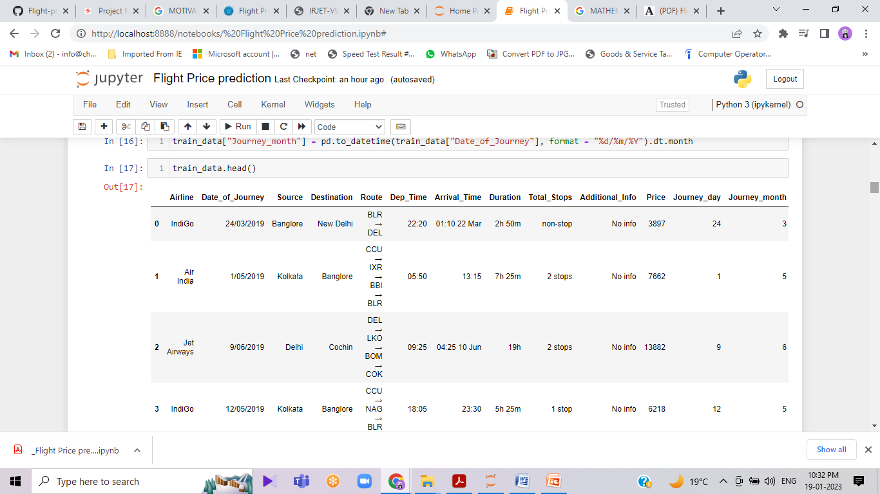
DATA SOURCES AND THEIR FORMATS
Kaggle lets in customers to discover and put up data sets, discover and construct fashions in a web-primarily based totally factstechnology data science environment, paintings with different facts scientists and device mastering engineers, and input competitions to resolve data science challenges.

Slide 9
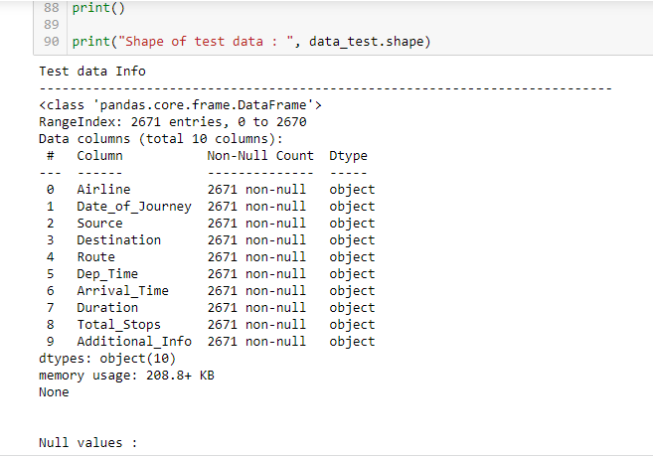
CHECKING THE NUMBER OF NULL VALUES IN THE DATASET

Slide 10
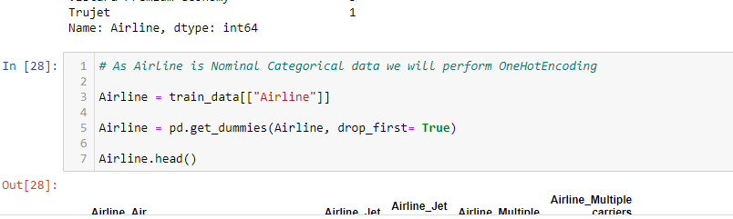
DATA PREPROCESSING
Data pre-processing in Machine Learning refers to the technique of preparing (cleaning and organizing) the raw data to make it suitable for a building and training Machine Learning models. In other words, whenever the data is gathered from different sources it is collected in raw format which is not feasible for the analysis. Data pre-processing is an integral step in Machine Learning as the quality of data and the useful information that can be derived from it directly affects the ability of our model to learn; therefore, it is extremely important that we pre- process our data before feeding it into our model.
CHECKING THE VALUE COUNTS OF CATEGORICAL DATA

Slide 11
Data Inputs- Logic- Output Relationships
Feature selection is the system of decreasing the wide variety of input variables while making a predictive model. It is ideal to lessen the wide variety of input variables to each lessen the computational value of modeling and, in a few cases, to enhance the overall performance of the model. The problem belongs to the Airline domain so booking ticket date of the flight and date of journey is more important, also flight duration is more impact on the out put
Any change in the flight duration and ticket booking and date of journey change in output (flight ticket price)

Slide 12
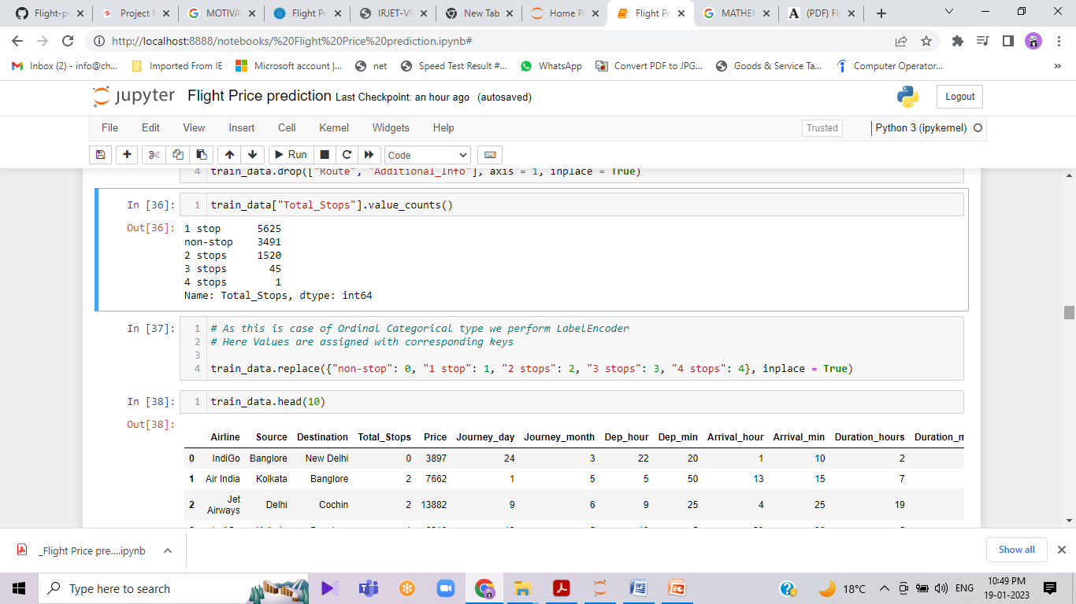
State the set of assumptions (if any) related to the problem under consideration
Algorithm used in our model is Random forest. Random forest is supervised machine learning algorithm. It is a collection of multiple decision trees whose results are aggregated into one final result. As the name suggests, "Random Forest is a classifier that contains a multiple number of decision trees on various subsets of the given dataset and takes the average to improve the predictive or final accuracy of that dataset

Slide 13
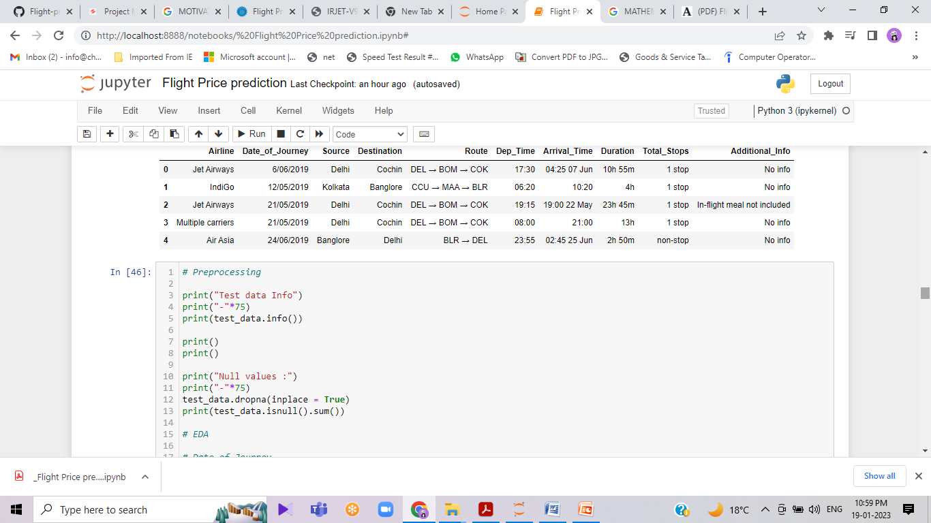
Model/s Development and Evaluation Identification of possible problem-solving approaches (methods)
These techniques are taking into consideration numerous financial, advertising, business and social elements intently linked with the very last airfare charges. It may be tough to betthe airfare price tag fee whilst. We test it nowadays as compared to the alternative day. The vacationers who need to go to a brand new location need to realize the price tag fee to be able to get the most inexpensive and positive price tag fee with their needs. This whole thing brings the concept to make a prediction approximately the flight tickets to be able to make the vacationers simpler to book their tickets with their needs. Due to the excessive complexity of the pricing fashions implemented with the aid of using the airlines, it's miles very tough a client to buy an air price tag with inside the lowest fee, for the reason that fee modifications dynamically.

Slide 14
Testing of Identified Approaches (Algorithms)
The decision tree appears to be the most well-known and commonly employed categorization technique. A decision tree is a collection of nodes that resembles a diagram, for each junction indicating a test on the a characteristic and each branch indicating a test outcome, such that each node in a decision tree (terminal node) has a class label. A tree can be "trained" by dividing the resources collection into subgroups depending on a characteristic values test. This procedure is known as partitioning the data because it is performed iteratively on each derived subset. The recursion ends when all subgroups at a node have the same posterior probability, or when the split no longer adds additional value to the predictions. A decision tree is appropriate for experimental extracting knowledge since it does not need subject matter expertise or parameters configuration.

Slide 15

Testing of Identified Approaches (Algorithms)
A Random Forest is an ensemble approach that can handle simultaneous regression and classification problems by combining many decision trees using a technique known as Bootstrap as well as Aggregation, or bagging. The core idea is to use numerous decision trees to determine the final result instead of depending on personal decision trees. Random Forest's foundation learning methods are numerous decision trees. We arbitrarily choose rows and characteristics from the dataset to create sample datasets for each model. This section is known as Bootstrap. We simply have to understand the purity in our dataset, and we'll use that characteristic as the root of the tree which has the smallest impurity or, in other words, the smallest Gini index. Mathematically Gini index can be written as:

Slide 16
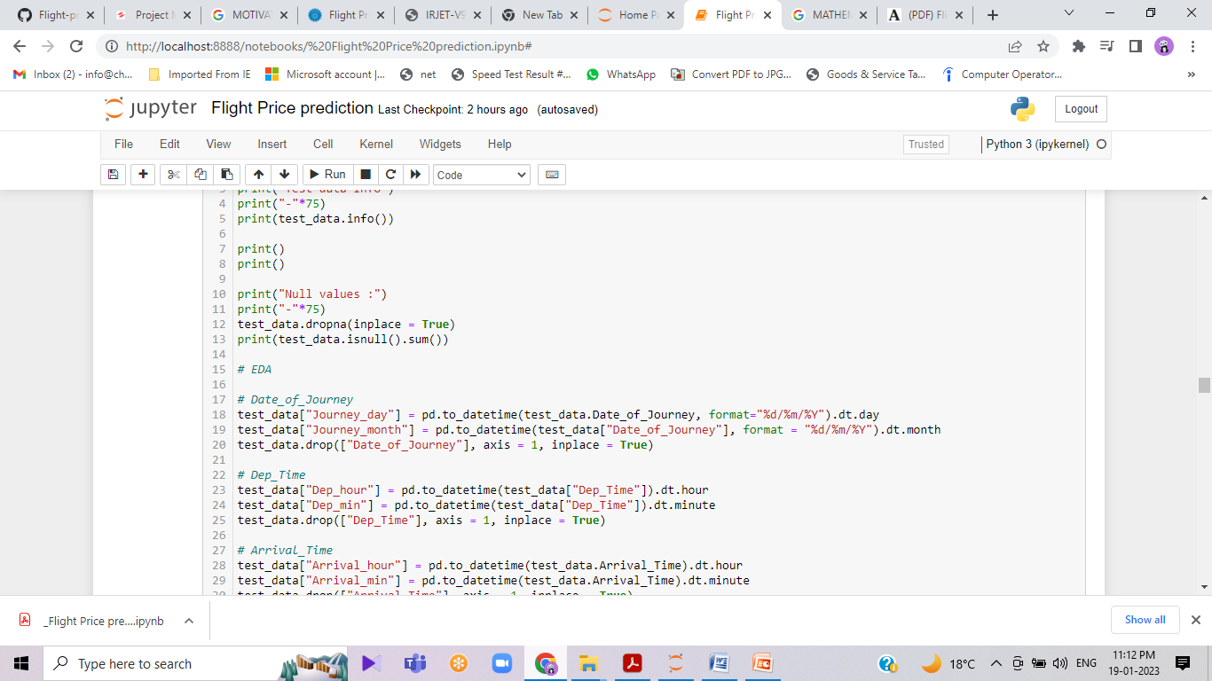
Run and Evaluate selected models
A correlation matrix is a tabular data representing the ‘correlations’ between pairs of variables in a given dataset. It is also a very important pre-processing step in Machine Learning pipelines. The Correlation matrix is a data analysis representation that is used to summarize data to understand the relationship between various different variables of the given dataset.

Slide 17
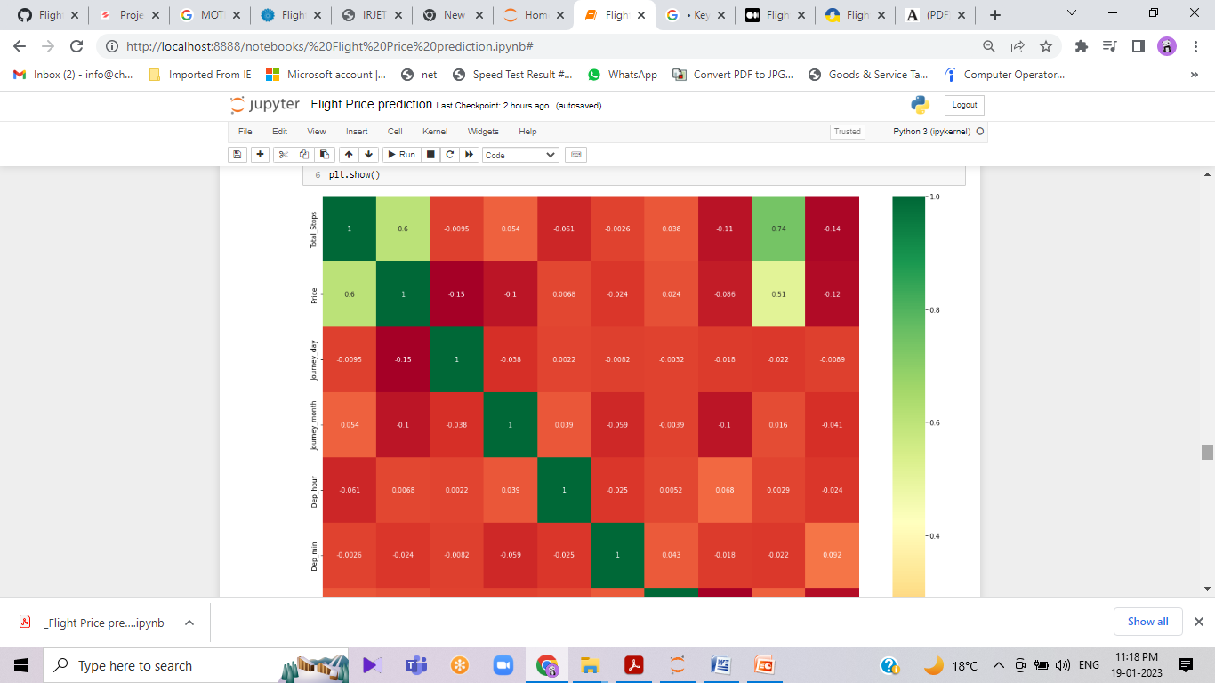
Key Metrics for success in solving problem under consideration
Airline, Source, Destination, Route, Total_Stops, Additional_info are the categorical variables we have in our data. Let’s handle each one by one.
Nominal data → are not in any order → OneHotEncoder is used in this case
Ordinal data → are in order → LabelEncoder is used in this case

Slide 18
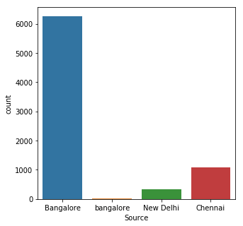
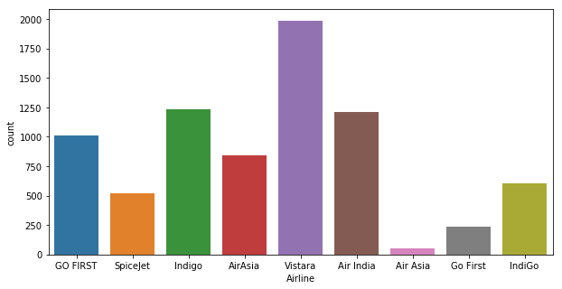
Visualizations
Mention all the plots made along with their pictures and what were the inferences and observations obtained from those. Describe them in detail.
Observation : Data set contains the highest number of flight data from Bangalore
Observation: Airline vistara have highest number of flights

Slide 19
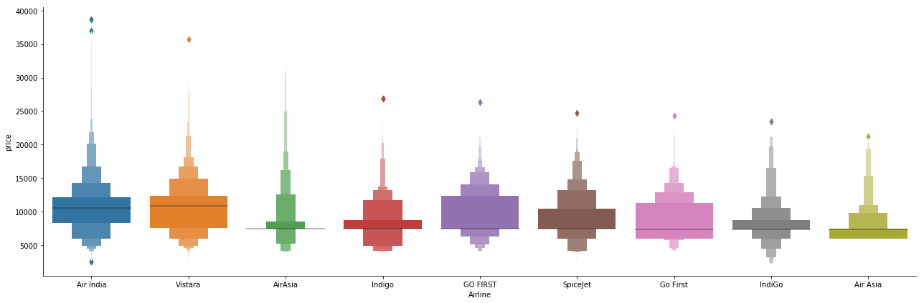
Catplot:
Observation: Air India have highest Air fare compare to other airlines and cheapest airline Air aisa

Slide 20
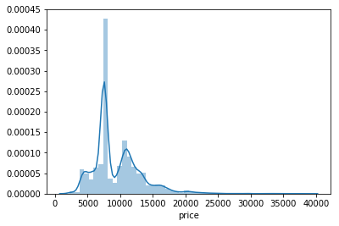
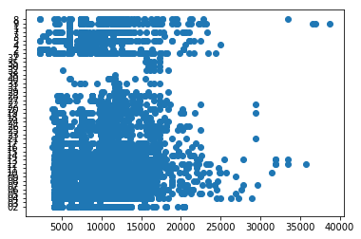
Price and Hour scatter plot
Observation: Highly Price distribution happened between 5000 to 10000 Rupees

Slide 21
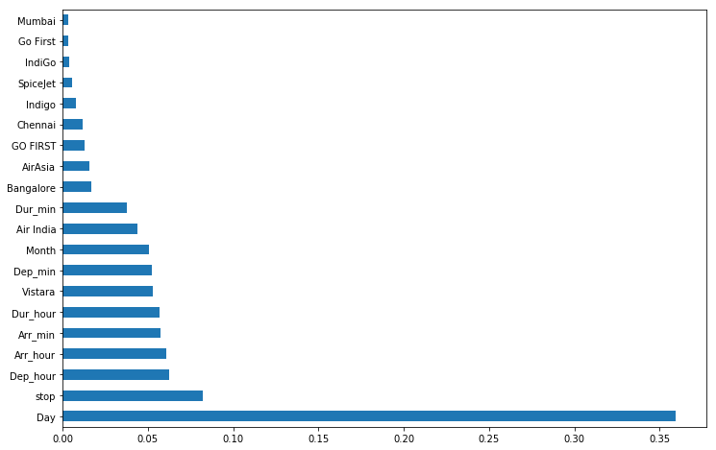
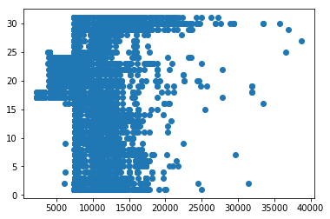
Observation: Bar plots show the clearly feature variables Day and stop ,Dep_hour, dur_hour, Arr_hour have high correlation between the target variables
Price and Day scatter plot

Slide 22
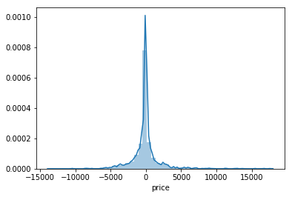
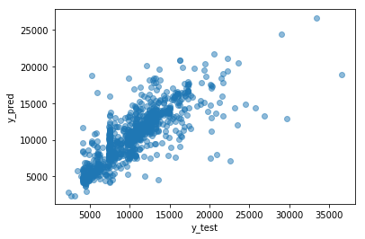
Fig: Test score of the y_test, and y_pred
Fig: Scatter plot of y_test and y_pred

Slide 23
CONCLUSION
Key Findings and Conclusions of the Study
Three machine learning models were examined in this case study to forecast the average flight price at the business segment level. We used training data to train the training data and test data to test it. These records were used to extract a number of characteristics. Our suggested model can estimate the quarterly average flight price using attribute selection strategies.To the highest possible standard, much prior studies into flight price prediction using the large dataset depended on standard statistical approaches, which have their own limitations in terms of underlying issue estimates and hypotheses. To our knowledge, no other research have included statistics from holidays, celebrations, stock market price fluctuations, depression, fuel price, and socioeconomic information to estimate the air transport market sector; nonetheless, there are numerous restrictions.As example, neither of the databases provide precise information about ticket revenue, including such departing and arrival times and days of the week. This framework may be expanded in the future to also include airline tickets payment details, that can offer more detail about each area, such as timestamp of entry and exit, seat placement, covered auxiliary items, and so on. By merging such data, it is feasible to create a more robust and complete daily and even daily flight price forecast model. Furthermore, a huge surge of big commuters triggered by some unique events might alter flight costs in a market sector. Thus, incident data will be gathered from a variety of sources, including social media sites and media organizations, to supplement our forecasting models. We will also examine specific technological Models, such as Deeper Learning methods, meanwhile striving to enhance existing models by modifying their hyper-parameters to

Slide 24
Learning Outcomes of the Study in respect of Data Science
This paper reported on a preliminary study in “airfare prices prediction”. We gathered airfare data from a Kaggle website and showed that it is feasible to predict prices for flights based on historical fare data. The experimental results show that ML models are a satisfactory tool for predicting airfare prices. Other important factors in airfare prediction are the data collection and feature selection from which we drew some useful conclusions. From the experiments we concluded which features influence the airfare prediction at most. Limitations of this work and Scope for

Slide 25
Future Work
selection is the system of decreasing the wide variety of input variables while making a predictive model. It is ideal to lessen the wide variety of input variables to each lessen the computational value of modeling and, in a few cases, to enhance the overall performance of the model.

Slide 26
THANK YOU

